Slide 1

Optimal Allocation of Taxis for Uber
Group 1
Ivan Bakbin
Qiao Xitao
Goh Choon Guan

Slide 2
1
2
Increased Ridership since COVID-19
Dynamic supply and demand of cabs
Optimisation of Driver Proportion Allocation that aims to maximise Uber’s profits
Literature Review:
01
02
Deng et al. (1992)
Venus
Utilized cost-analysis approach, taking into account fixed, variable and opportunity costs
Venus has a very beautiful name, but it’s terribly hot

Slide 3
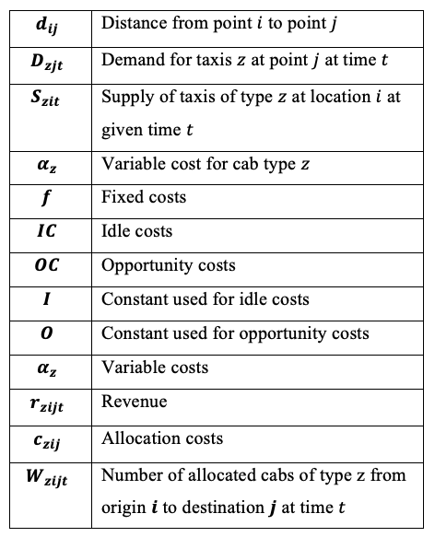
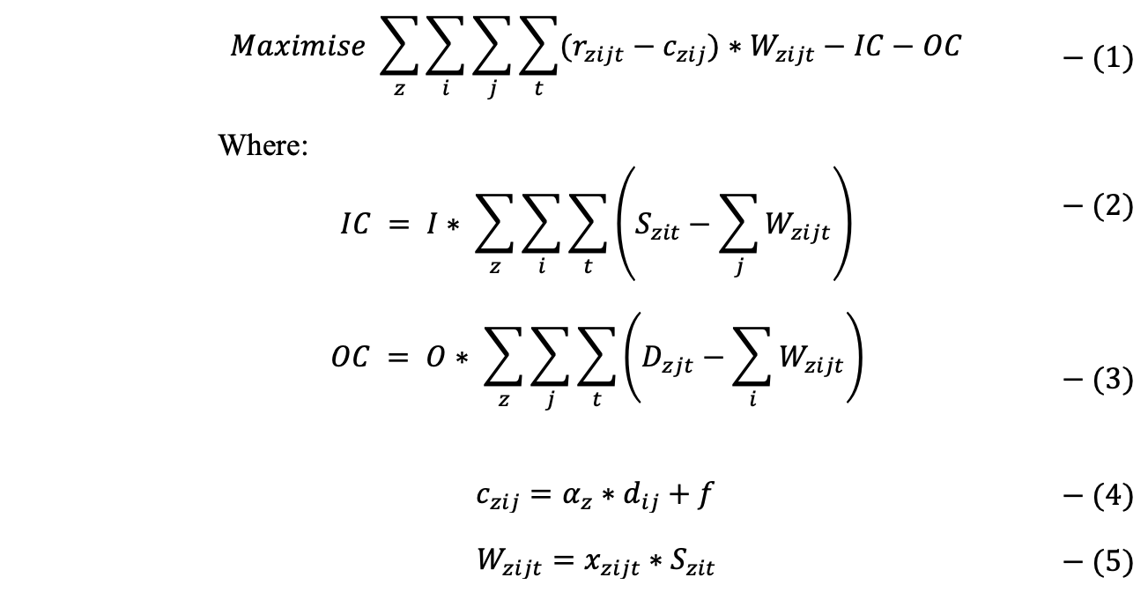
Model——Objective Function
Notes:
Our objective function is to maximize the total profit for allocation, which means we should consider the price and cost for each allocation.
Besides that, we introduce two other novel cost into our model, which are Idle cost and opportunity cost respectively. Because we want to make the most advantage of our supply or capacity and to reach the highest satisfaction rate concerning the transaction fulfillment.
IC: constant for the capacity not fully utilized
OC: constant for the demand not satisfied
C: take into account the variable cost and fixed cost, and the variable cost should be related to different types of cabs.
W: we tried using ILP to solve our model, which is to optimize the number of cabs, but it turned out that we should spend at least 10 hours on average to run our model, so we introduce another decision variable x to represent the proportion we send based on supply of cabs we have. In this way we can transform our model into a LP problem.

Slide 4
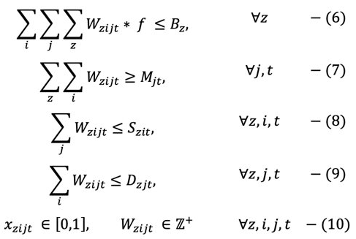
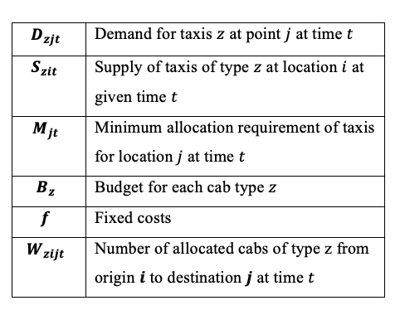
Model——Constraints
Notes:
Budget: We have limited financial resource for the cabs operation in Boston, especially for the fixed cost.
Minimum: We don’t want to see the extreme unbalance of allocation between different destination, and for the marketing purpose, we cannot allow any of our competitor to conquer a specific market, even if the profit for this allocation is not profitable enough.
Supply & Demand: the number of cabs we allocate should be lower than supply and demand we previously set.
And for our decision variable: x should between 0 and 1. the number of cabs allocated should be integer.

Slide 5
Results + Limitations

Slide 6
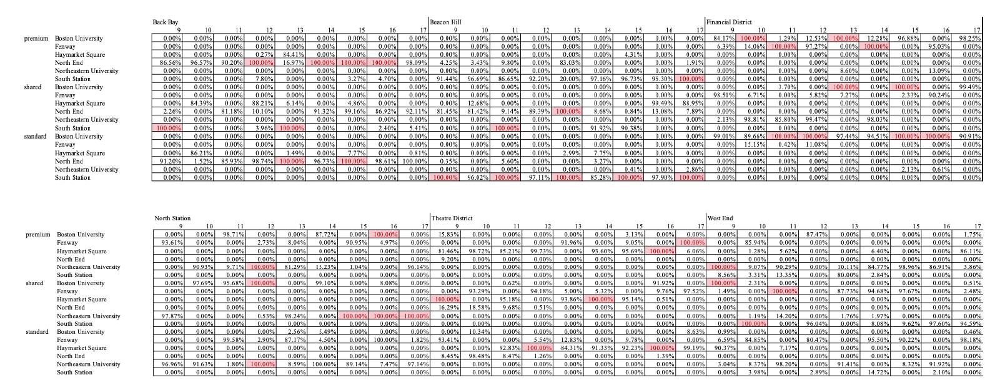
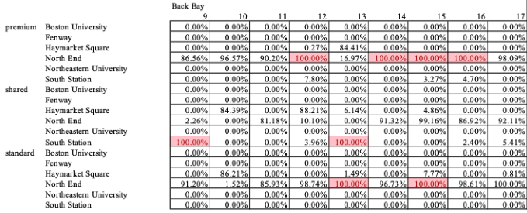
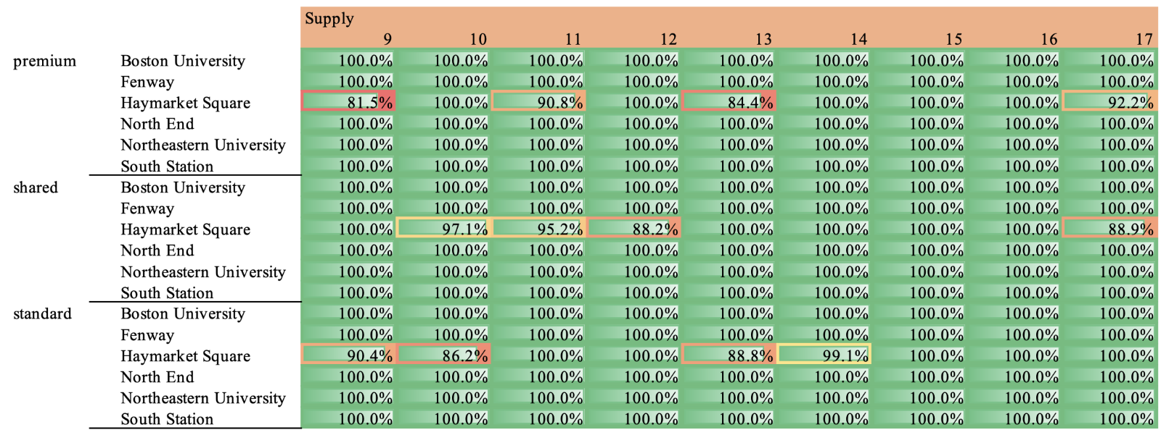
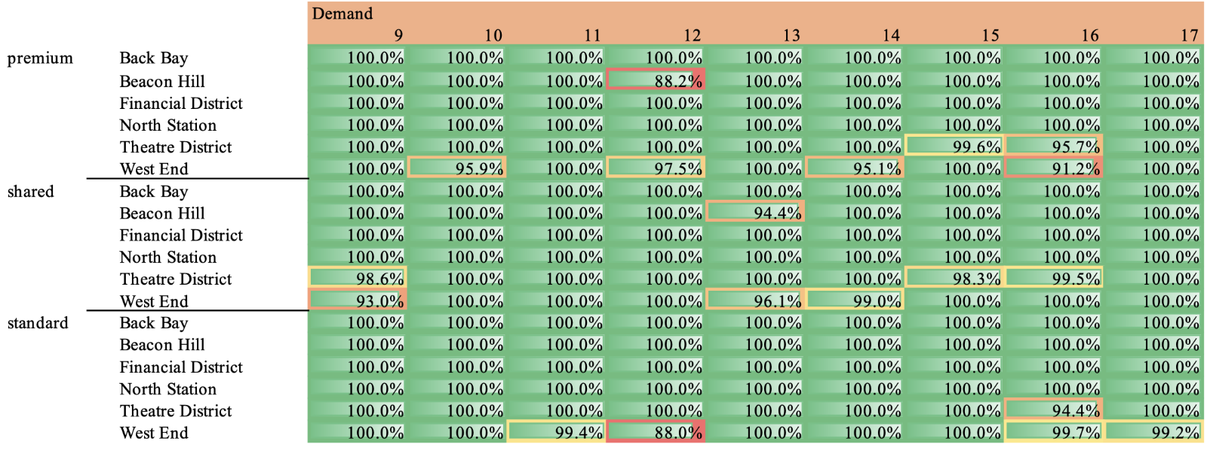
Computational Results

Slide 7
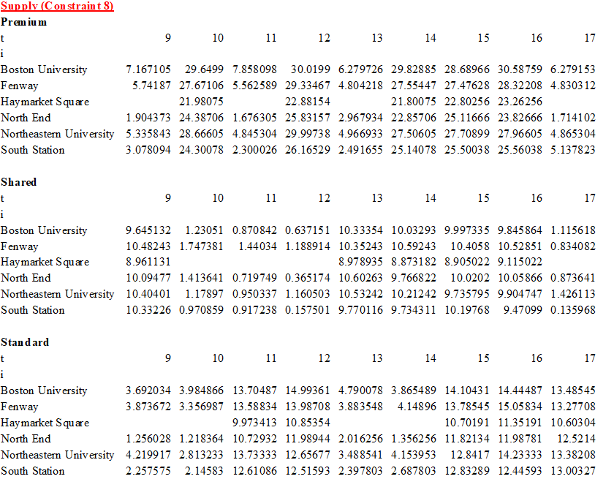
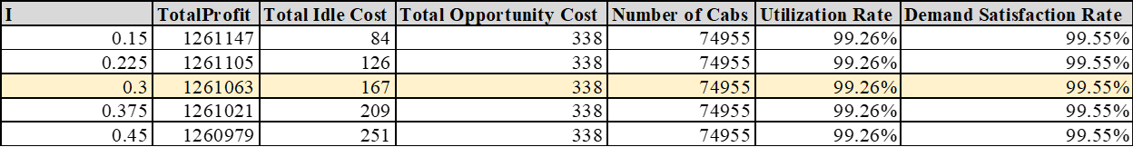
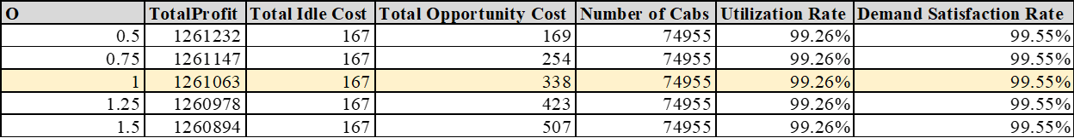
Sensitivity Analysis

Slide 8
Taxi Infographics
01
02
03
04
Mercury
Venus
Jupiter
Mars
It is the closest planet to the Sun and the smallest one
Venus has a very beautiful name, but it’s terribly hot
Jupiter is a huge gas giant named after the Roman god
Mars is a red cold planet and is full of iron oxide dust

Slide 9
Taxi Infographics
65 %
75 %
Jupiter
Saturn
Jupiter is the biggest planet of them all
Saturn is a planet with several rings
30 %
55 %
Venus
Earth
Venus has a really beautiful name
The Earth is the third planet from the Sun

Slide 10
Taxi Infographics
1
2
3
4
Saturn
Mercury
Venus
The Earth
Saturn is the ringed one. It’s a gas giant
Mercury is the closest planet to the Sun
Venus is the second planet from the Sun
The Earth is the planet where we all live

Slide 11
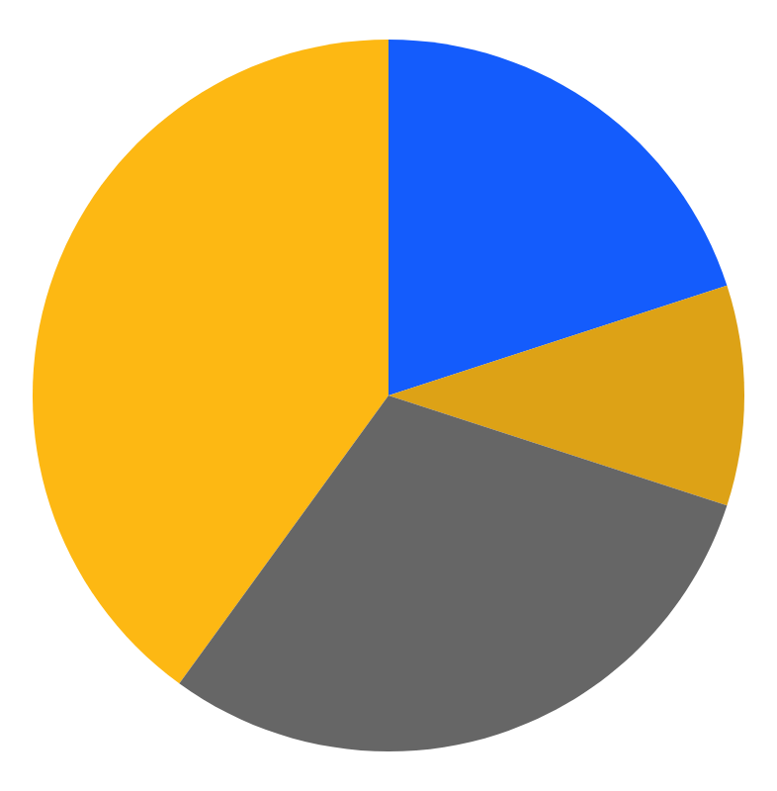
Taxi Infographics
Mars
Mercury
Despite being red, Mars is very cold
It is the closest planet to the Sun
Venus
Jupiter
It has a beautiful name, but it’s hot
It is the biggest planet of them all
Follow the link in the graph to modify its data and then paste the new one here. For more info, click here

Slide 12
Taxi Infographics
Jupiter
Saturn
Jupiter is the biggest planet of them all
Yes, Saturn is a gas giant with several rings
02
04
01
03
05
Mars
Mercury
The Earth
Despite being red Mars is actually a very cold place
Mercury is the smallest planet of them all
The Earth is the only planet that harbours life

Slide 13
Taxi Infographics
1
2
3
Saturn
Mercury
Venus
Saturn is the ringed one. It’s a gas giant
Mercury is the closest planet to the Sun
Venus is the second planet from the Sun

Slide 14
Taxi Infographics
Pick up date
Pick up time
Mercury is the closest planet to the Sun and the smallest one in the System
The Earth is the third planet from the Sun and the only one that harbors life
M | T | W | T | F | S | S
01 | 02 | 03 | 04 | 05 | 06 | 07
08 | 09 | 10 | 11 | 12 | 13 | 14
15 | 16 | 17 | 18 | 19 | 20 | 21
22 | 23 | 24 | 25 | 26 | 27 | 28
29 | 30 | 31
0 h
3 h
24 h

Slide 15
Taxi Infographics
Jupiter
Saturn
Jupiter is the biggest planet of them all
Saturn is a gas giant that has lots of rings
Mars
Mercury
Despite being red, Mars is a very cold place
Mercury is the smallest planet of them all

Slide 16
Taxi Infographics
Mercury
Mercury is the smallest planet of them all
Mars
Despite being red, Mars is a very cold place
Jupiter
Jupiter is the biggest planet of them all
Venus
Venus has a beautiful name, but it’s very hot

Slide 17
Taxi Infographics
Step 1
Step 2
Step 3
Mercury
Venus
The Earth
Mercury is the closest planet to the Sun
Venus is the second planet from the Sun
The Earth is the planet where we all live

Slide 18
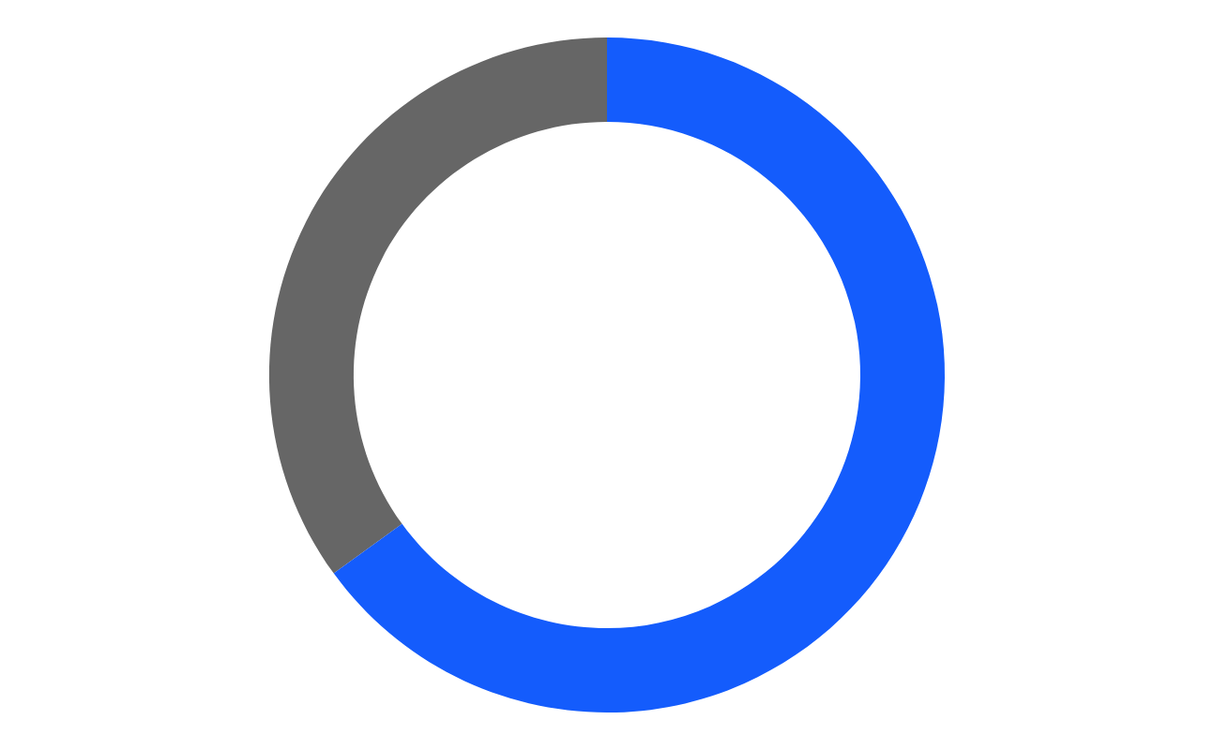
Taxi Infographics
35 %
Mercury
Mercury is the closest planet to the Sun and the smallest one
65 %
Jupiter
Jupiter is a gas giant and the biggest planet of them all
Follow the link in the graph to modify its data and then paste the new one here. For more info, click here

Slide 19
Taxi Infographics
Mercury
Mars
Jupiter
Mercury is the closest planet to the Sun
Despite being red, Mars is a cold planet
Jupiter is the biggest planet of them all
Venus
Earth
Venus has a beautiful name but is hot
The Earth is the planet that harbours life

Slide 20
Taxi Infographics
Mercury
Venus
Mercury is the closest planet to the Sun
Venus is a very hot planet with a nice name
50 %
25 %

Slide 21
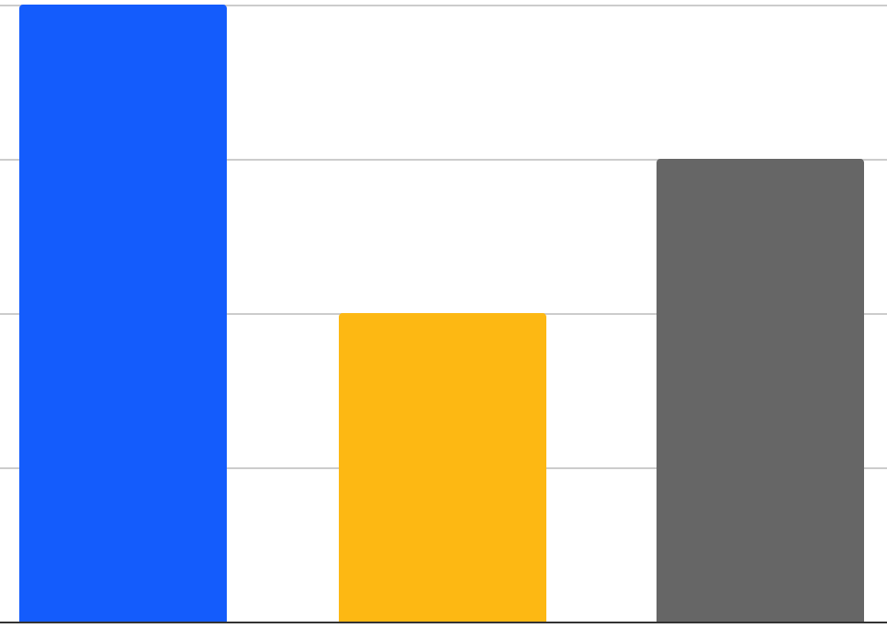
Taxi Infographics
100 %
50 %
Mercury
Mercury
It is the closest planet to the Sun and the smallest
Despite being red, Mars is actually a very cold planet
75 %
Jupiter
Jupiter is a gas giant and the biggest planet
Follow the link in the graph to modify its data and then paste the new one here. For more info, click here

Slide 22
Taxi Infographics
01
02
03
Saturn
Mercury
Venus
Saturn is the ringed one. It’s a gas giant
Mercury is the closest planet to the Sun
Venus is the second planet from the Sun

Slide 23
Taxi Infographics
Mercury
Earth
Mercury is the closest planet to the Sun
The Earth is the only one that harbours life
50 %
75 %
Venus
Mars
Venus has a beautiful name, but it’s hot
Despite being red, Mars is a cold place
25 %
25 %

Slide 24
Taxi Infographics
 | Taxi 1 | Taxi 2 | Taxi 3
Driver
Route
Car

Slide 25
Taxi Infographics
60 %
40 %
Mercury
Mars
Mercury is the closest planet to the Sun and the smallest one
Despite being red, Mars is actually a really cold planet

Slide 26
Taxi Infographics
01
Mercury
Mars
02
It is the closest planet to the Sun and the smallest
Despite being red, Mars is actually a very cold place
03
Venus
Jupiter
04
Venus has a beautiful name, but it’s very hot
Taxi Service
Jupiter is a gas giant and the biggest planet
05
The Earth
Saturn
06
The Earth is the third planet and harbours life
Saturn is a gas giant and has several rings

Slide 27
Taxi Infographics
Venus
100 %
Venus has a beautiful name and is the second planet from the Sun. It’s terribly hot, even hotter than Mercury, and its atmosphere is extremely poisonous. It’s the second-brightest natural object in the night sky
Mercury
It is the closest planet to the Sun and the smallest
25 %
The Earth
The Earth is the third planet. It’s where we live
%

Slide 28
Taxi Infographics
Mercury
01
Mercury is the closest planet to the Sun
Venus
02
Venus has a nice name. It is extremely hot
75 %
25 %

Slide 29
Taxi Infographics
Neptune
Mars
Neptune is the farthest planet from the Sun
Despite being red, Mars is a really cold place
25 %
25 %
Venus
Venus has a beautiful name, but it’s hot
50 %

Slide 30
Taxi Infographics
20 %
20 %
Mercury
Mars
It is the closest planet to the Sun
Mars is full of iron oxide dust
30 %
30 %
Jupiter
Venus
Jupiter is the biggest planet
Venus has a nice name, but it’s hot

Slide 31
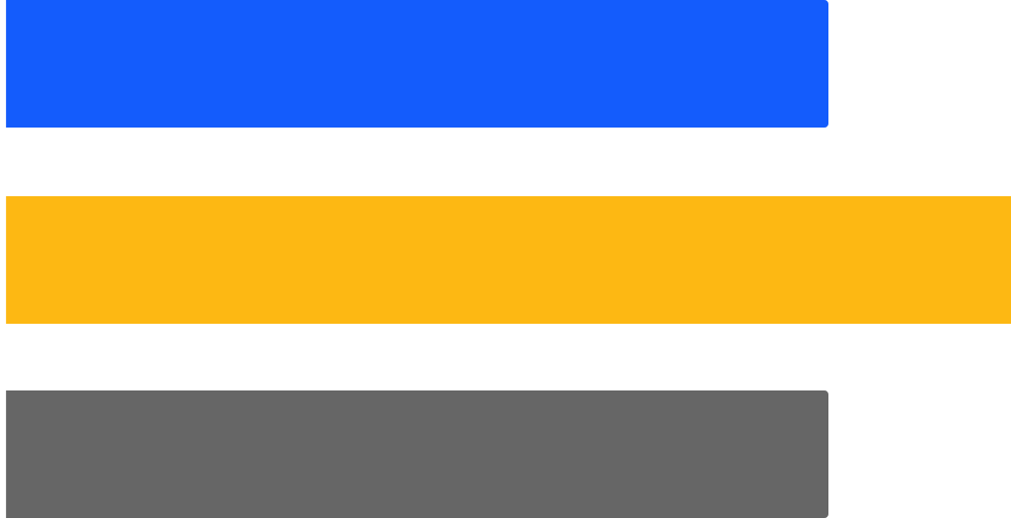
Taxi Infographics
Neptune
80 %
Neptune is the farthest planet from the Sun
Venus
100 %
Venus has a beautiful name, but it’s hot
Mars
80 %
Despite being red, Mars is a really cold place
Follow the link in the graph to modify its data and then paste the new one here. For more info, click here

Slide 32
Taxi Infographics
A
Jupiter
A
Jupiter is a huge gas giant named after the Roman god of the skies and lightning
25 %
B
Saturn
B
Saturn is a gas giant and has several rings. It's composed of hydrogen and helium
75 %

Slide 33
Taxi Infographics
Venus
Mars
It has a beautiful name, but it’s hot
Despite being red, Mars is a cold place
Mercury
Earth
Jupiter
It is the closest planet to the Sun
The Earth is the third planet from the Sun
It is a gas giant and the biggest planet

Slide 34
Taxi Infographics
The Earth
01
02
Mars
The Earth is the third planet from the Sun
Despite being red, Mars is a cold place
Venus
03
04
Jupiter
It has a beautiful name, but it’s hot
It is a gas giant and the biggest planet
Mercury
05
06
Saturn
It is the closest planet to the Sun
Saturn is a gas giant and has several rings

Slide 35
Taxi Infographics
01
Jupiter
Jupiter is a huge gas giant named after the Roman god of the skies and lightning
02
Saturn
Saturn is a gas giant and has several rings. It's composed of hydrogen and helium

Slide 36
Taxi Infographics
75 %
45 %
Mercury
Mars
Mercury is the closest planet to the Sun and the smallest
Despite being red, Mars is actually a very cold place
255 %
30 %
Jupiter
Venus
Jupiter is a gas giant and the biggest planet
Venus has a beautiful name, but it’s a really hot planet

Slide 37
Taxi Infographics
 | Week 1 | Week 2 | Week 3 | Week 4
District 1
District 2
District 3

Slide 38
Taxi Infographics
01
02
03
04
The Earth
Venus
Mercury
Mars
The Earth is the third planet. It harbours life
Venus has a beautiful name, but is very hot
It is the closest planet to the Sun and the smallest
Despite being red, Mars is actually a very cold place

Slide 39
Instructions for use (free users)
In order to use this template, you must credit Slidesgo by keeping the Thanks slide.
You are allowed to:
Modify this template.
Use it for both personal and commercial purposes.
You are not allowed to:
Sublicense, sell or rent any of Slidesgo Content (or a modified version of Slidesgo Content).
Distribute this Slidesgo Template (or a modified version of this Slidesgo Template) or include it in a database or in any other product or service that offers downloadable images, icons or presentations that may be subject to distribution or resale.
Use any of the elements that are part of this Slidesgo Template in an isolated and separated way from this Template.
Delete the “Thanks” or “Credits” slide.
Register any of the elements that are part of this template as a trademark or logo, or register it as a work in an intellectual property registry or similar.
For more information about editing slides, please read our FAQs or visit Slidesgo School:
https://slidesgo.com/faqs and https://slidesgo.com/slidesgo-school

Slide 40
Instructions for use (premium users)
In order to use this template, you must be a Premium user on Slidesgo.
You are allowed to:
Modify this template.
Use it for both personal and commercial purposes.
Hide or delete the “Thanks” slide and the mention to Slidesgo in the credits.
Share this template in an editable format with people who are not part of your team.
You are not allowed to:
Sublicense, sell or rent this Slidesgo Template (or a modified version of this Slidesgo Template).
Distribute this Slidesgo Template (or a modified version of this Slidesgo Template) or include it in a database or in any other product or service that offers downloadable images, icons or presentations that may be subject to distribution or resale.
Use any of the elements that are part of this Slidesgo Template in an isolated and separated way from this Template.
Register any of the elements that are part of this template as a trademark or logo, or register it as a work in an intellectual property registry or similar.
For more information about editing slides, please read our FAQs or visit Slidesgo School:
https://slidesgo.com/faqs and https://slidesgo.com/slidesgo-school

Slide 41
Infographics
You can add and edit some infographics to your presentation to present your data in a visual way.
Choose your favourite infographic and insert it in your presentation using Ctrl C + Ctrl V or Cmd C + Cmd V in Mac.
Select one of the parts and ungroup it by right-clicking and choosing “Ungroup”.
Change the color by clicking on the paint bucket.
Then resize the element by clicking and dragging one of the square-shaped points of its bounding box (the cursor should look like a double-headed arrow). Remember to hold Shift while dragging to keep the proportions.
Group the elements again by selecting them, right-clicking and choosing “Group”.
Repeat the steps above with the other parts and when you’re done editing, copy the end result and paste it into your presentation.
Remember to choose the “Keep source formatting” option so that it keeps the design. For more info, please visit Slidesgo School.

